Slide 1
Boston Housing
Price Analysis
Multilinear Regression Analysis on
Housing Prices
Nugrah Nurrohman / 28-08-2025

Slide 2
Executive
Summary
Combining socioeconomic (lstat, ptratio, black), environmental (nox, dis), structural (rm, tax, indus), and accessibility (rad, zn, chas, crim) variables provides a more balanced and accurate predictor of housing prices.
A cross-validation approach (LOOCV) was applied to evaluate model performance.
The model achieved a prediction error rate of ~15, an error of ~15 means the model is, on average, off by about $15,000.
There is a significant improvement of error rate of simpler single-variable or lower-degree models (which showed errors in the 20–30+ range).
Boston Housing Price Analysis

Slide 3
Context
Definition
The following describes the dataset columns:
CRIM - per capita crime rate by town
ZN - proportion of residential land zoned for lots over 25,000 sq.ft.
INDUS - proportion of non-retail business acres per town.
CHAS - Charles River dummy variable (1 if tract bounds river; 0 otherwise)
NOX - nitric oxides concentration (parts per 10 million)
RM - average number of rooms per dwelling
AGE - proportion of owner-occupied units built prior to 1940
DIS - weighted distances to five Boston employment centres
RAD - index of accessibility to radial highways
TAX - full-value property-tax rate per $10,000
PTRATIO - pupil-teacher ratio by town
B - 1000(Bk - 0.63)^2 where Bk is the proportion of blacks by town
LSTAT - % lower status of the population
MEDV - Median value of owner-occupied homes in $1000's
The Boston Housing Dataset is a derived from information collected by the U.S. Census Service concerning housing in the area of Boston MA.

Slide 4
Methodology
& Tools Used
Methods:
Multilinear Regression
Cross-Validation
Tools:
R
ChatGPT

Slide 5
Key
Findings

Slide 6
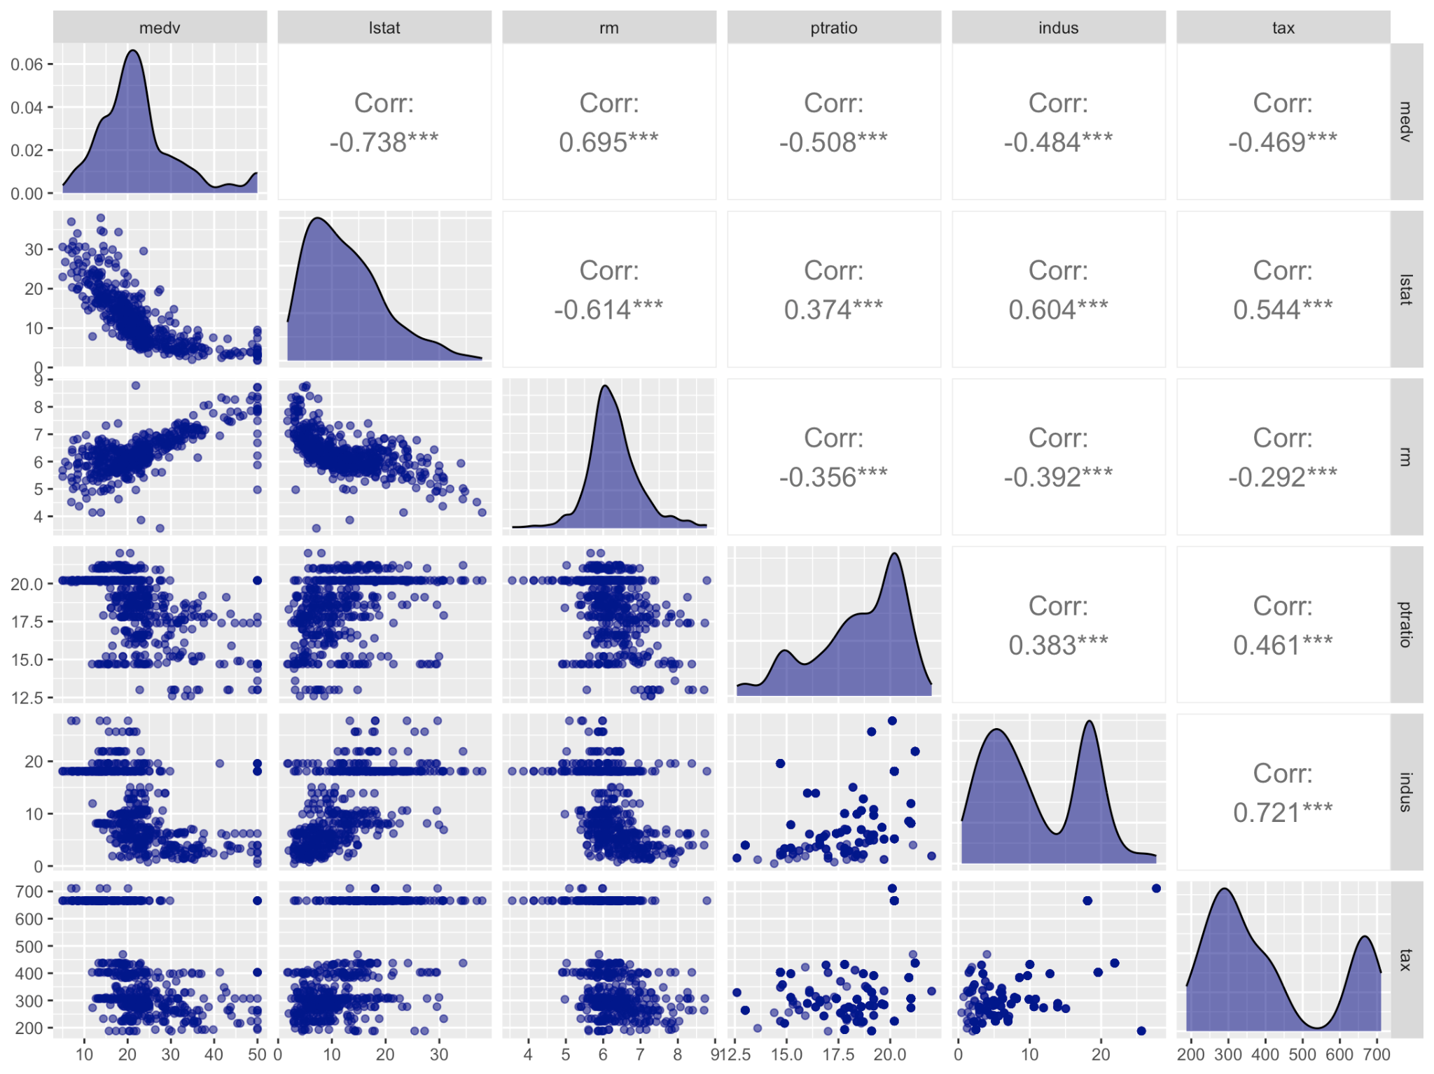
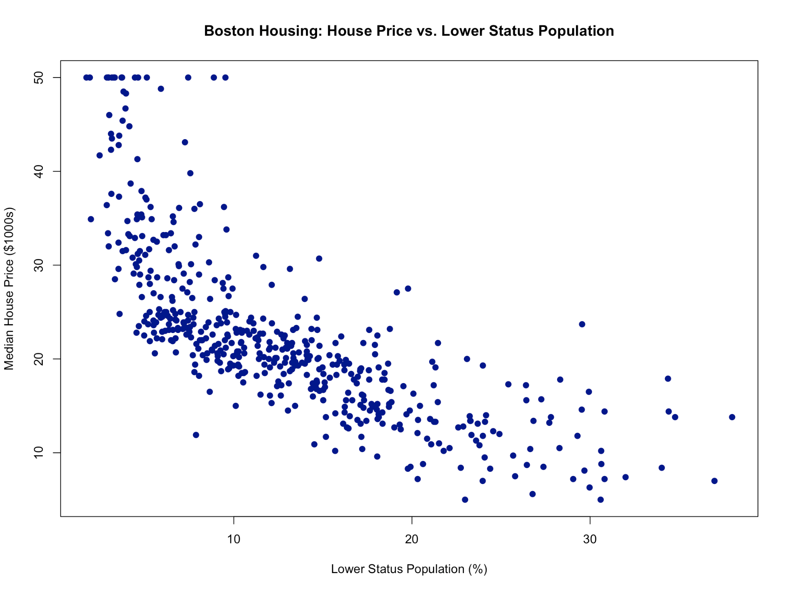
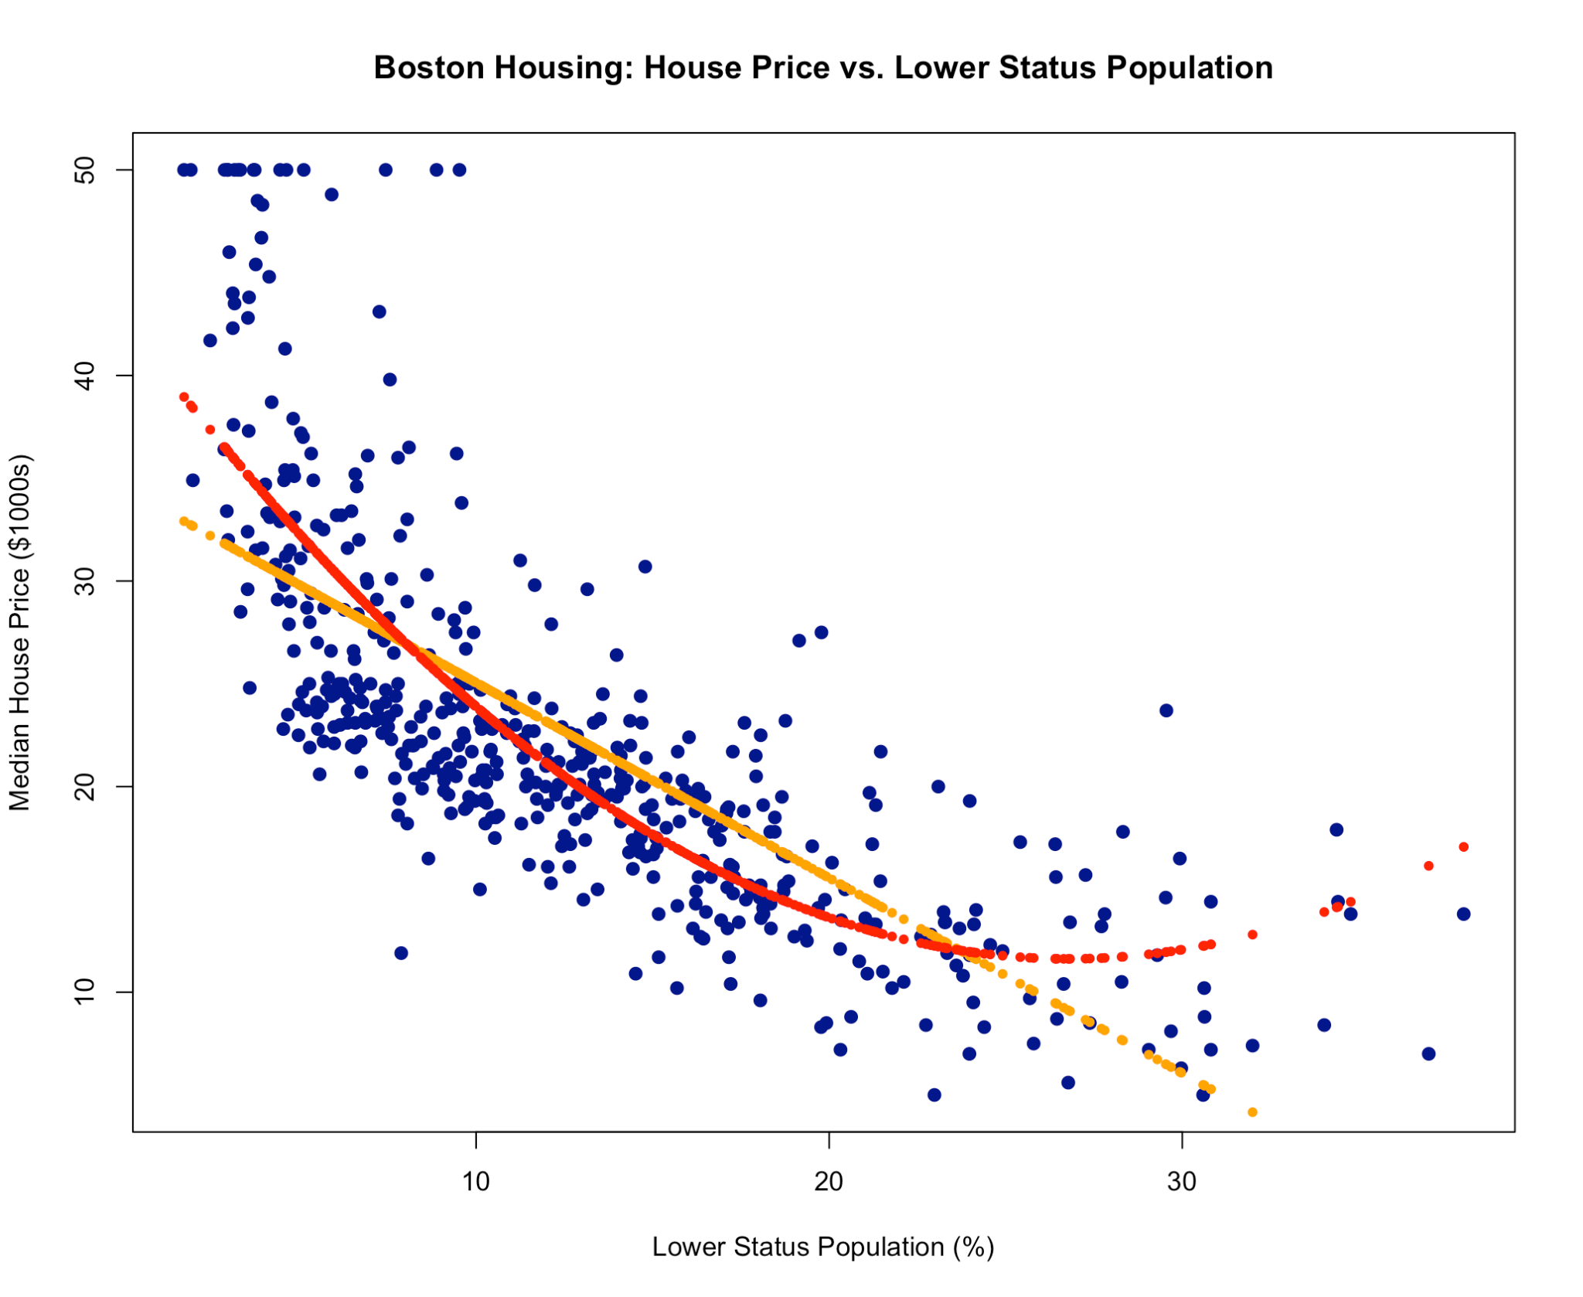
Most Correlated Variable with House price
Medv( Median Value of Owner-Occupied homes in $1000’s)
LSTAT - % lower status of the population
RM - average number of rooms per dwelling
PTRATIO - pupil-teacher ratio by town
INDUS - proportion of non-retail business acres per town.
TAX - full-value property-tax rate per $10,000

Slide 7
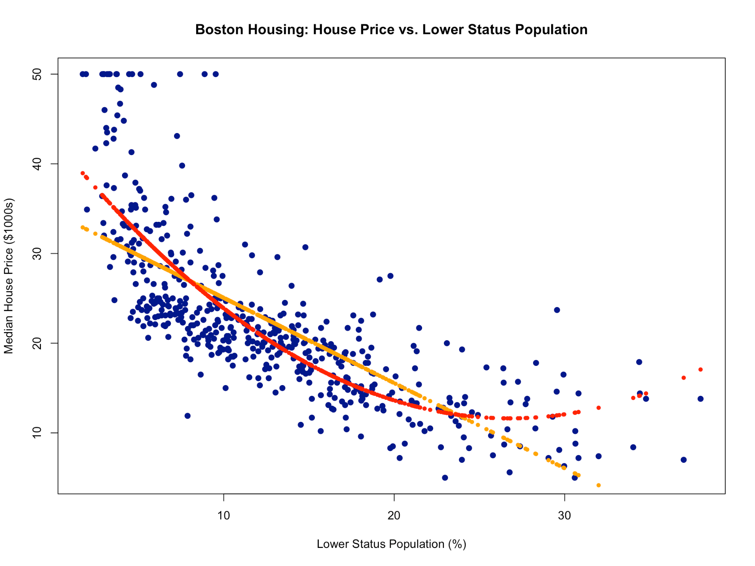
House Price
vs Lower Status
Population
Linear vs Polynomial
Higher lstat level decrease
the house price

Slide 8
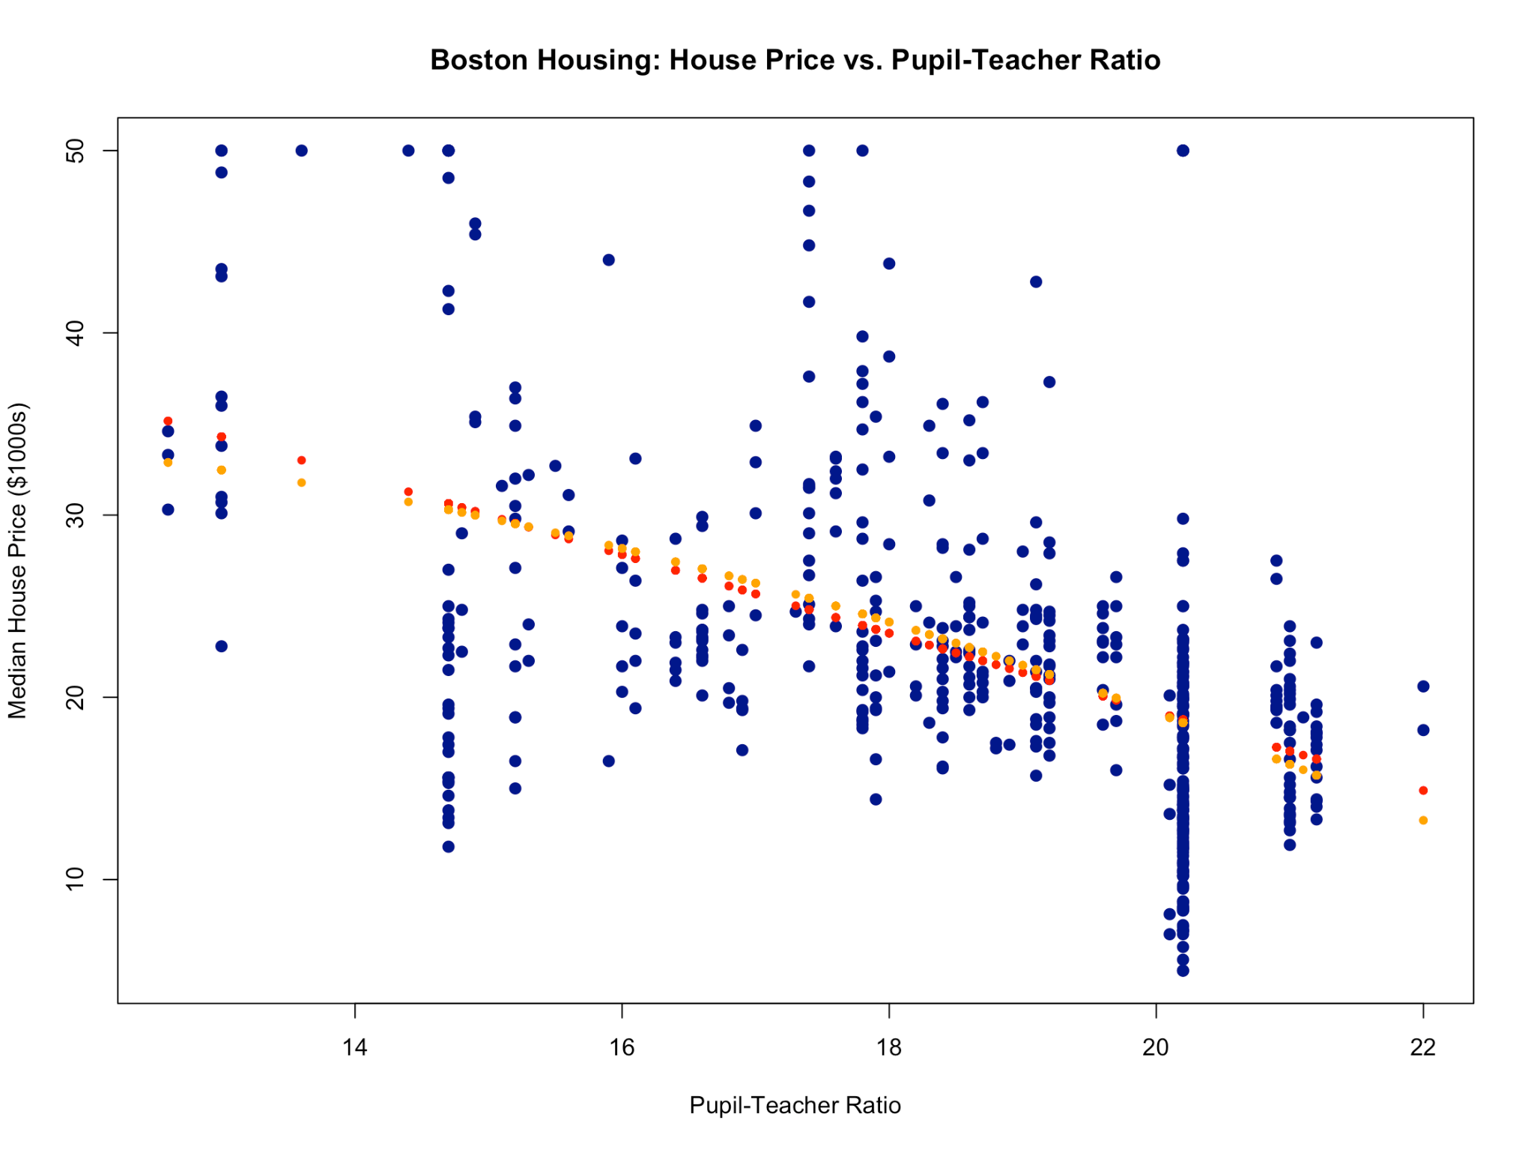
House Price
vs Pupil-Teacher Ratio
Linear vs Polynomial
Higher ptratio (
more student
than teacher)
decrease
the house price

Slide 9
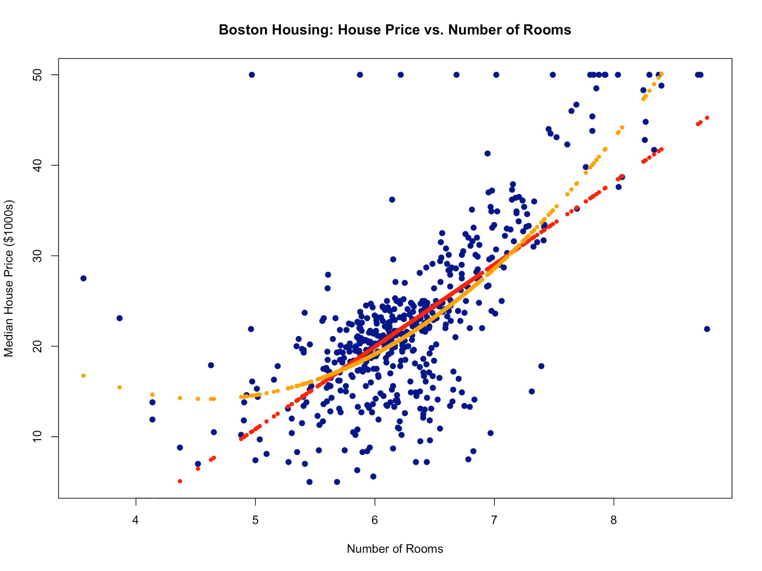
House Price
vs Number of Rooms
Linear vs Polynomial
More room increase
the house price

Slide 10
Interactional model
(Deeper insight)
-More room in lstat dense area will decrease the price.
Individually rm increase the house price but adding interaction, people see bigger house don’t fit in the higher lstat dense area.
- High dense lstat area with high ptratio also decrease the price
Variable | Coefficient
lstat:rm | -1.26352
lstat:ptratio | -0.36864

Slide 11
Model
Performance
Implementing LOOCV
(Leave- one-out cross validation) on various model

Slide 12
Single variable
Vs
Multiple Variable
Variable | Error Rate
lstat | 38.89010
ptratio | 63.24516
rm | 44.21666
lstat+ nox+ptratio+tax+black+rad+dis+rm+nox+chas+zn+crim+indus | 23.57196
More variables leads to lower prediction error in this dataset.

Slide 13
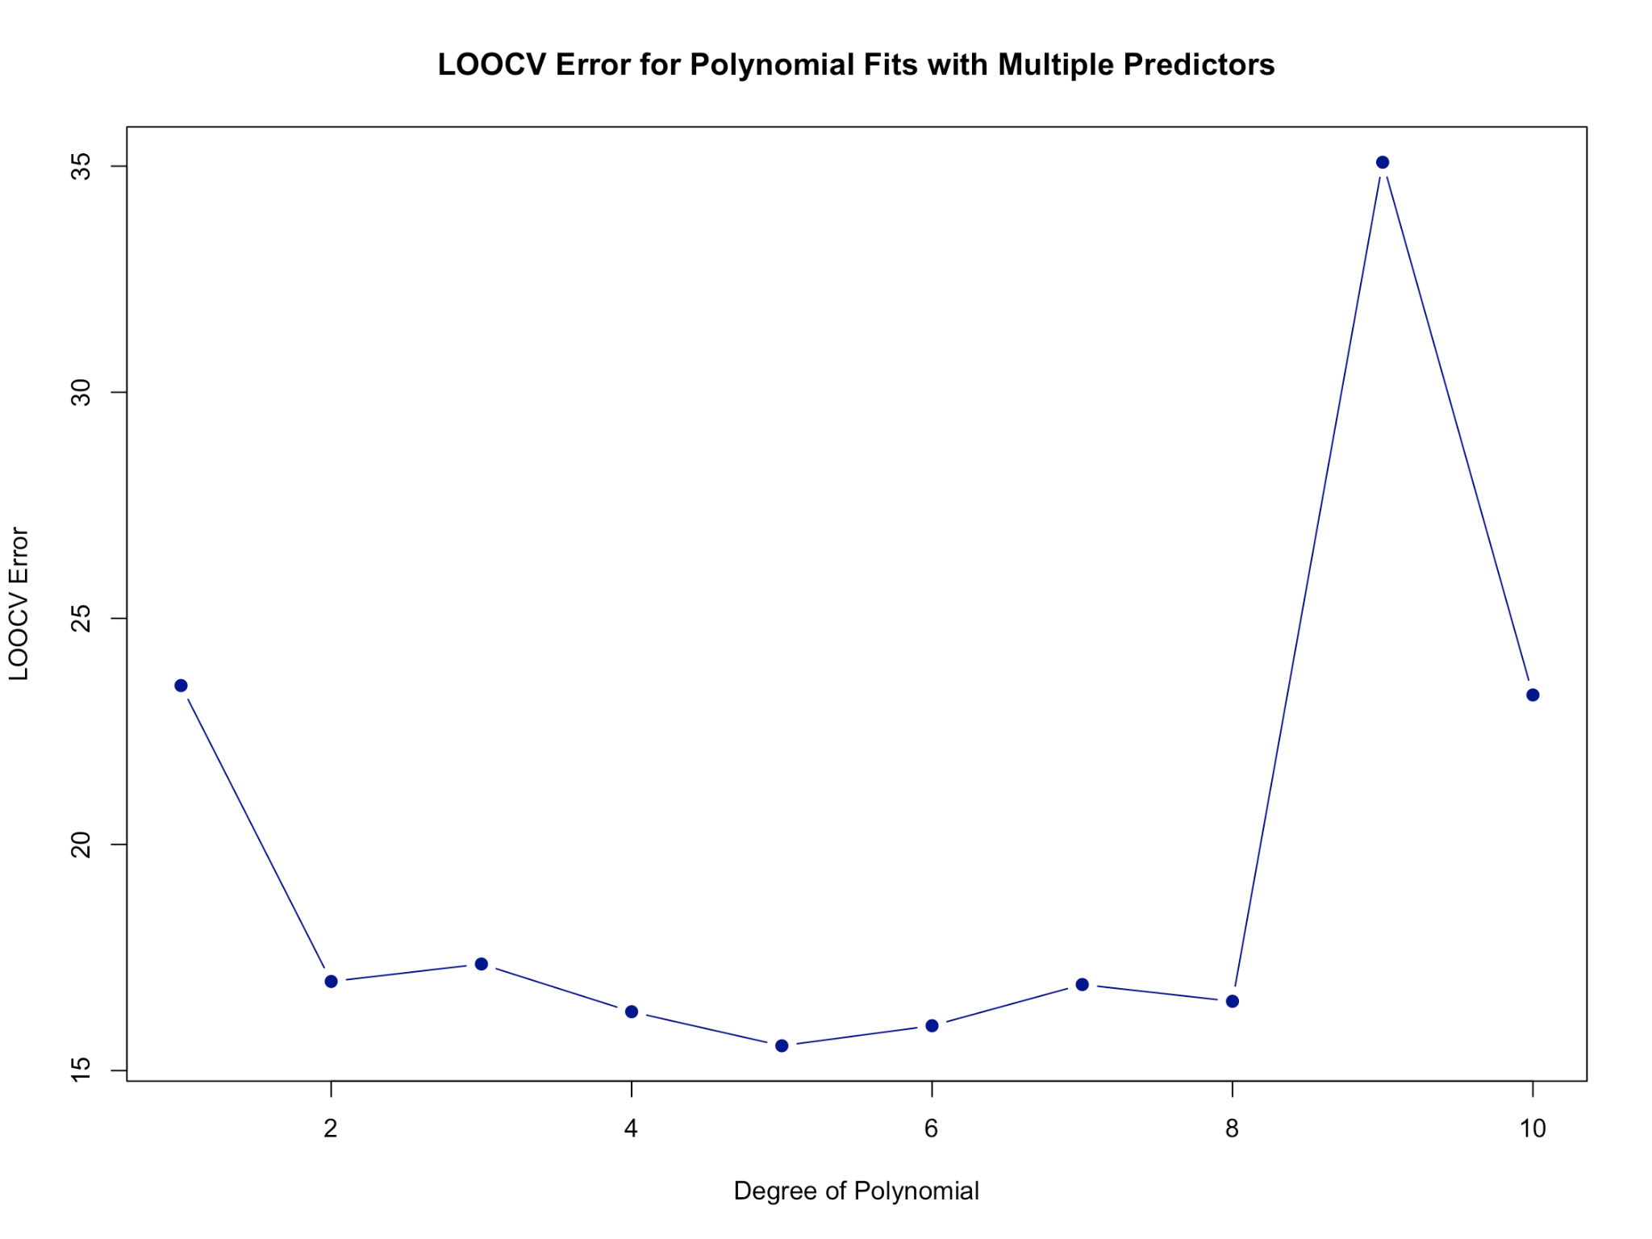
Multivariate model on various
degree
I used polynomial on lstat & rm and left other variable linear.
In the 2 degree model show sharp decline in error rate but the lowest is in the 5 degree and start to overfit in 9 degree

Slide 14
Conclusion
Combining socioeconomic (lstat, ptratio, black), environmental (nox, dis), structural (rm, tax, indus), and accessibility (rad, zn, chas, crim) variables provides a more balanced and accurate predictor of housing prices.
A cross-validation approach (LOOCV) was applied to evaluate model performance.
The model achieved a prediction error rate of ~15, an error of ~15 means the model is, on average, off by about $15,000.
There is a significant improvement of error rate of simpler single-variable or lower-degree models (which showed errors in the 20–30+ range).

Slide 15
Appendix
Linear model
fit1 <- lm(medv~lstat, data=boston);summary(fit1)
fit4h <- lm(medv~ptratio, data = boston); summary(fit4h)
fit8 <- lm(medv~rm,boston); summary(fit8)
fit11 <- lm(medv~lstat*ptratio*rm,boston); summary(fit11)
Loocv with various variable
# Fit more varible
glm.fit6 <- glm(medv ~lstat+ nox+ptratio+tax+black+rad+dis+rm+nox+chas+zn+crim+indus, data = Boston)
coef(glm.fit6)
# LOOCV (default K = n, so it's Leave-One-Out)
cv.error6 <- cv.glm(Boston, glm.fit6)
# Print LOOCV MSE
cv.error6$delta
cv.error6 <- rep(0, 10)
for (d in 1:10) {
glm.fit6 <- glm(medv ~ poly(lstat, d) + poly(rm, d) + ptratio + nox+ tax + black + rad + dis + chas + zn + crim ,
data = Boston)
cv.error6[d] <- cv.glm(Boston, glm.fit6)$delta[1]
}
cv.error6

